Slide 1
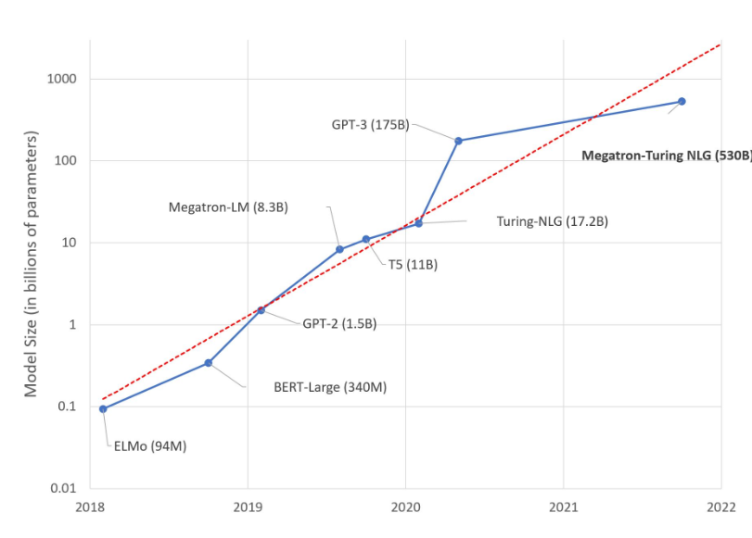
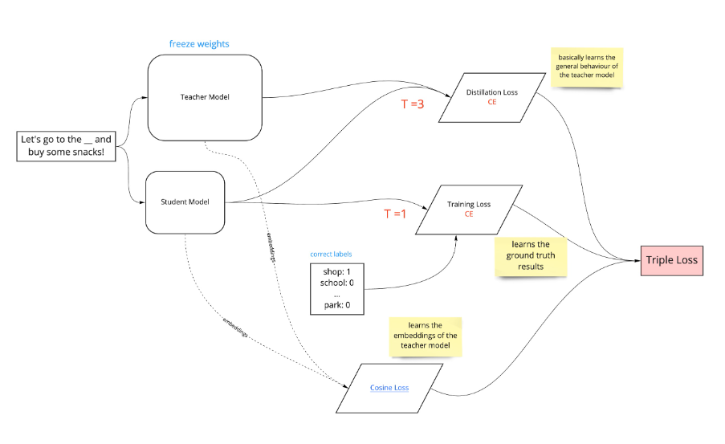
Knowledge Distillation On LLM
INTRODUCTION
RESEARCH
CONCLUSION
ABSTRACT
OBJECTIVES
MODELS
CONCLUSION
CITATIONS
BACKGROUND
METHODOLOGY
RESULTS
DISCUSSION
ACKNOWLEDGEMENT
CONTACT INFO
Xinru He
Saturn is a gas giant and has several rings. It's mostly composed of hydrogen and helium. It was named after the Roman god of wealth and agriculture
As language models continue to improve in performance, their size has also increased significantly. However, deploying these large models can be challenging. In this study, knowledge distillation is explored as a potential solution to this problem.
Deployment on resource-constrained devices.
Faster Inference speed
Reduce of fine-tuning cost
Smaller models can be trained more quickly and with less data, which can be helpful in situations where data is scarce or training resources are limited.
Smaller models can be more interpretable and easier to analyze, which can be important in fields such as healthcare or finance.
GPT2
50257 vocab size
1024 consecutive tokens
1.5 Billion parameter size
Decoder-only Transformer
Using knowledge distillation technique could largely reduce the parameter size of a LLM while maintaining the performance of the model.
TRAINING DATA
Radford, Alec, et al. "Language models are unsupervised multitask learners." OpenAI blog 1.8 (2019): 9.
Sanh, Victor, et al. "DistilBERT, a distilled version of BERT: smaller, faster, cheaper and lighter." arXiv preprint arXiv:1910.01108 (2019).
Geoffrey E. Hinton, Oriol Vinyals, and Jeffrey Dean. Distilling the knowledge in a neural network. ArXiv, abs/1503.02531, 2015.
large language models have become the cornerstone of many NLP tasks, demonstrating state-of-the-art performance. However, their size brings challenges and limitations for real-life applications, including environmental, training, inference, and deployment costs. Knowledge distillation is a promising technique for compressing large models into smaller ones while retaining their performance, making it feasible to deploy in resource-limited environments.
OpenWebTextCorpus
41.7 GB
plain text
1024 block size
BPE Tokenizing
Student-Teacher Model
Train a smaller model (student) to mimic the behavior of a larger model. (teacher) model.
Parameter Size
1.5 billion -> 82 million
Inference Speed
distilled GPT2 is 60% faster than GPT2
Three Losses Function
Some of the “near-zero” soft labels are larger than others and reflect different values. How should we use the information during the training process better.
Distillation Losses, Language Modeling Losses, Cosine-distance osses
 | GPT2 | DistillGPT2
wikitext-103 | 29.16 | 47.61
PTB | 35.86 | 85.56
enwik8 | 18 | 50.90
lambada | 45.28 | 100.01
common_gen | 1.07 | 10.26
Thank you professor Omar Alonso and Kenneth Church
he.xin@northeastern.edu

